Slide 1

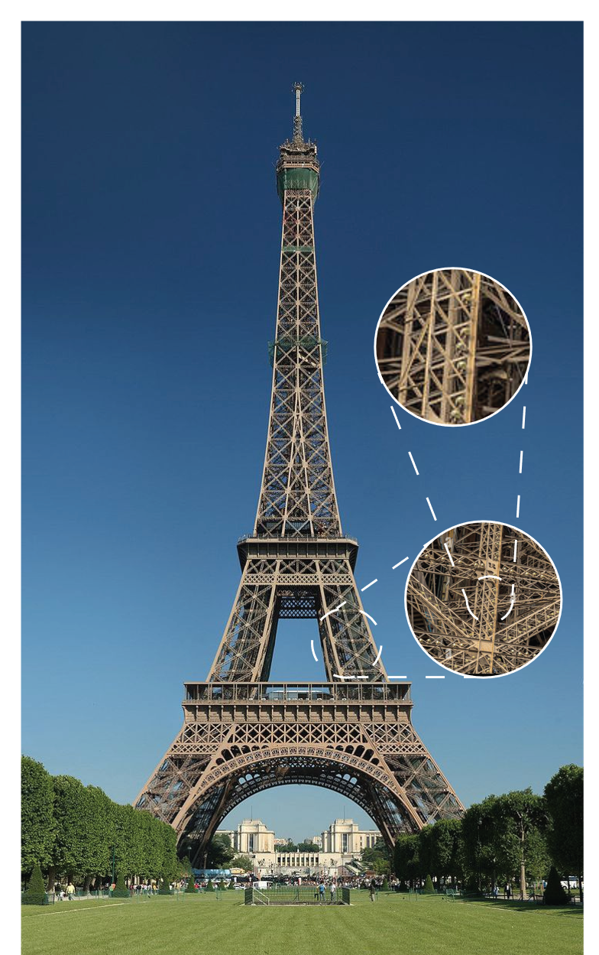
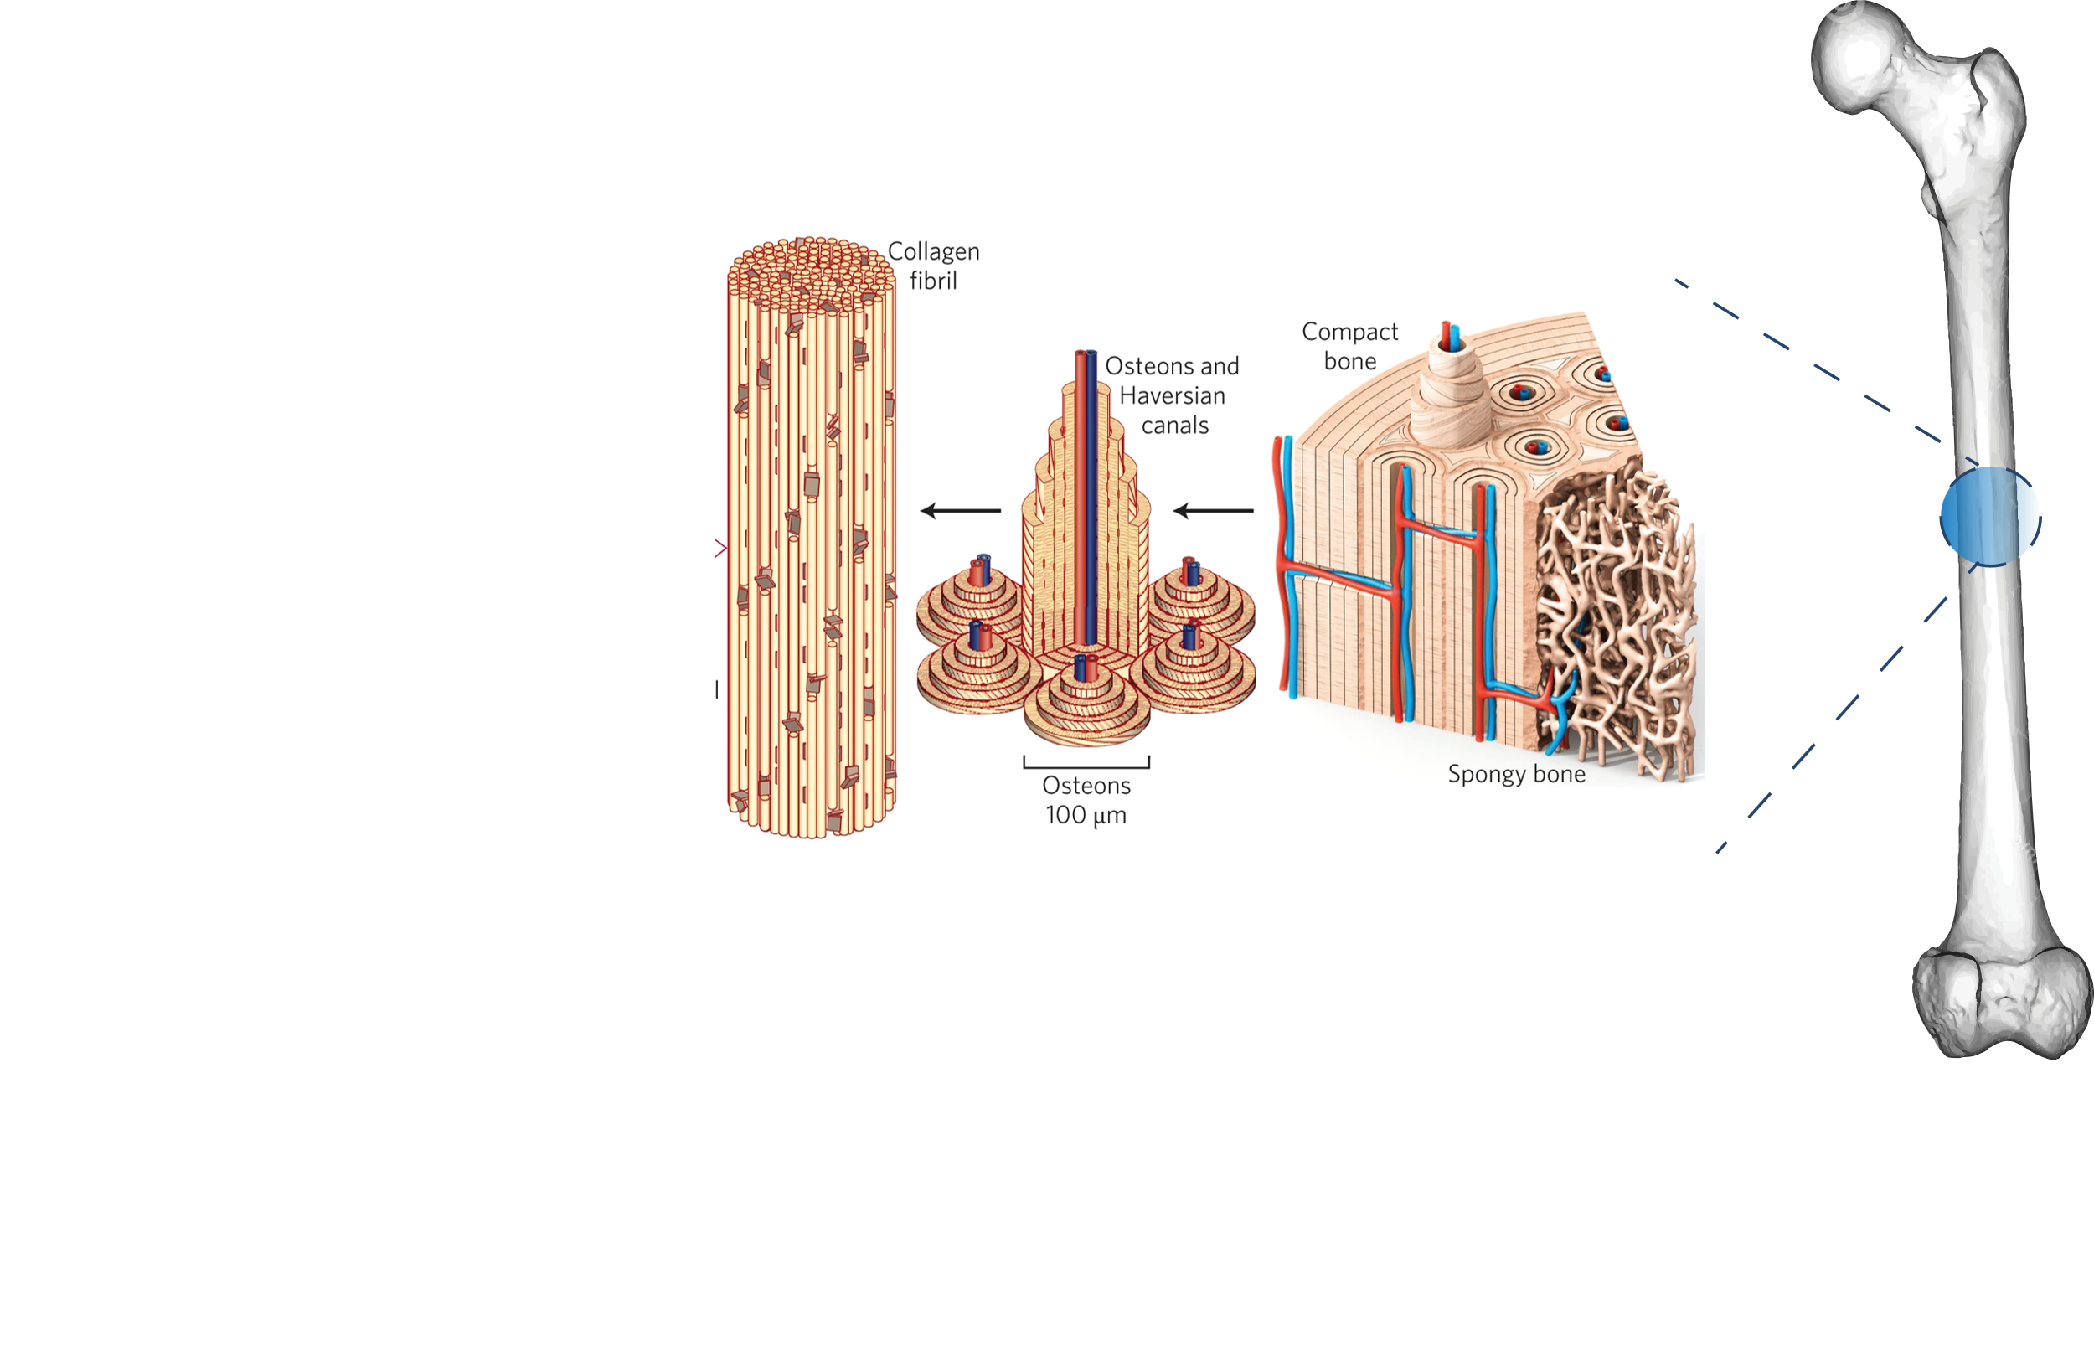
Hierarchical Complexity
3.03 cm
3.03 cm
GDR SoPhy 2025
Adapted from: Wegst, Ulrike GK, et al. "Bioinspired structural materials." Nature materials 14.1 (2015): 23-36.
Notes:
Biominerals are often composites of organic and inorganic components. A prominent example is bone, which consists of a mineralized framework embedded in a polymeric matrix.
1. Macroscale (whole bone)
At the largest scale, you’ll often see the cortical bone (dense outer shell) and trabecular bone (spongy interior).
This part highlights the bone’s role as a structural element — it can withstand big mechanical loads.
2. Microscale (osteons and lamellae)
Zooming in, you’ll see osteons: cylindrical units in cortical bone that contain concentric rings (lamellae) of mineralized collagen.
Tiny channels (Haversian canals) run through them, carrying blood vessels and nerves.
3. Sub-microscale (collagen fibrils & hydroxyapatite crystals)
The organic component: collagen fibrils (mostly type I collagen), long rope-like protein structures that give flexibility and toughness.
The inorganic component: hydroxyapatite crystals — a calcium phosphate mineral — which fill spaces within and around collagen fibrils, providing hardness and stiffness.
4. Nanoscale (mineralized collagen composite)
At this smallest scale, collagen fibrils have a regular banded pattern, and tiny hydroxyapatite platelets are embedded along their length.
This interpenetrating arrangement is why bone is strong in both compression (thanks to mineral) and tension (thanks to collagen).

Slide 2
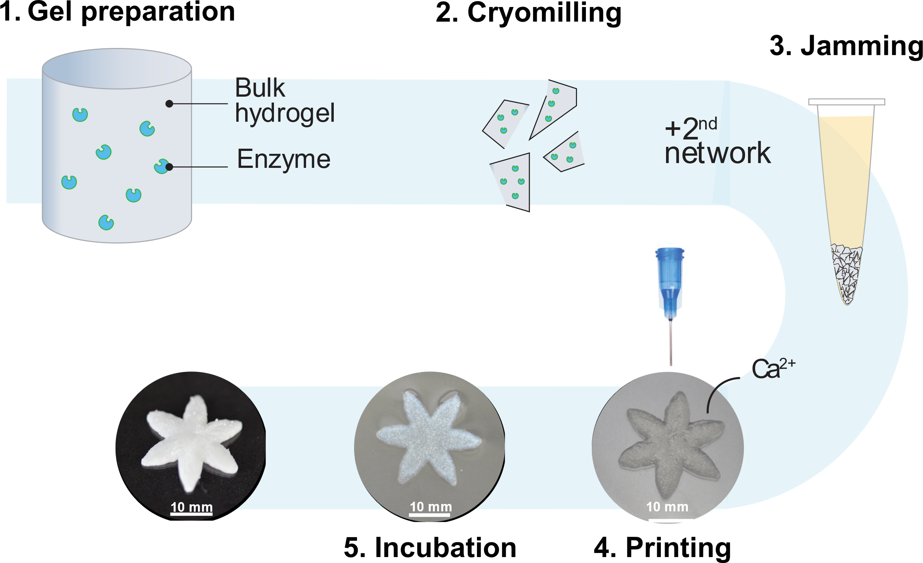
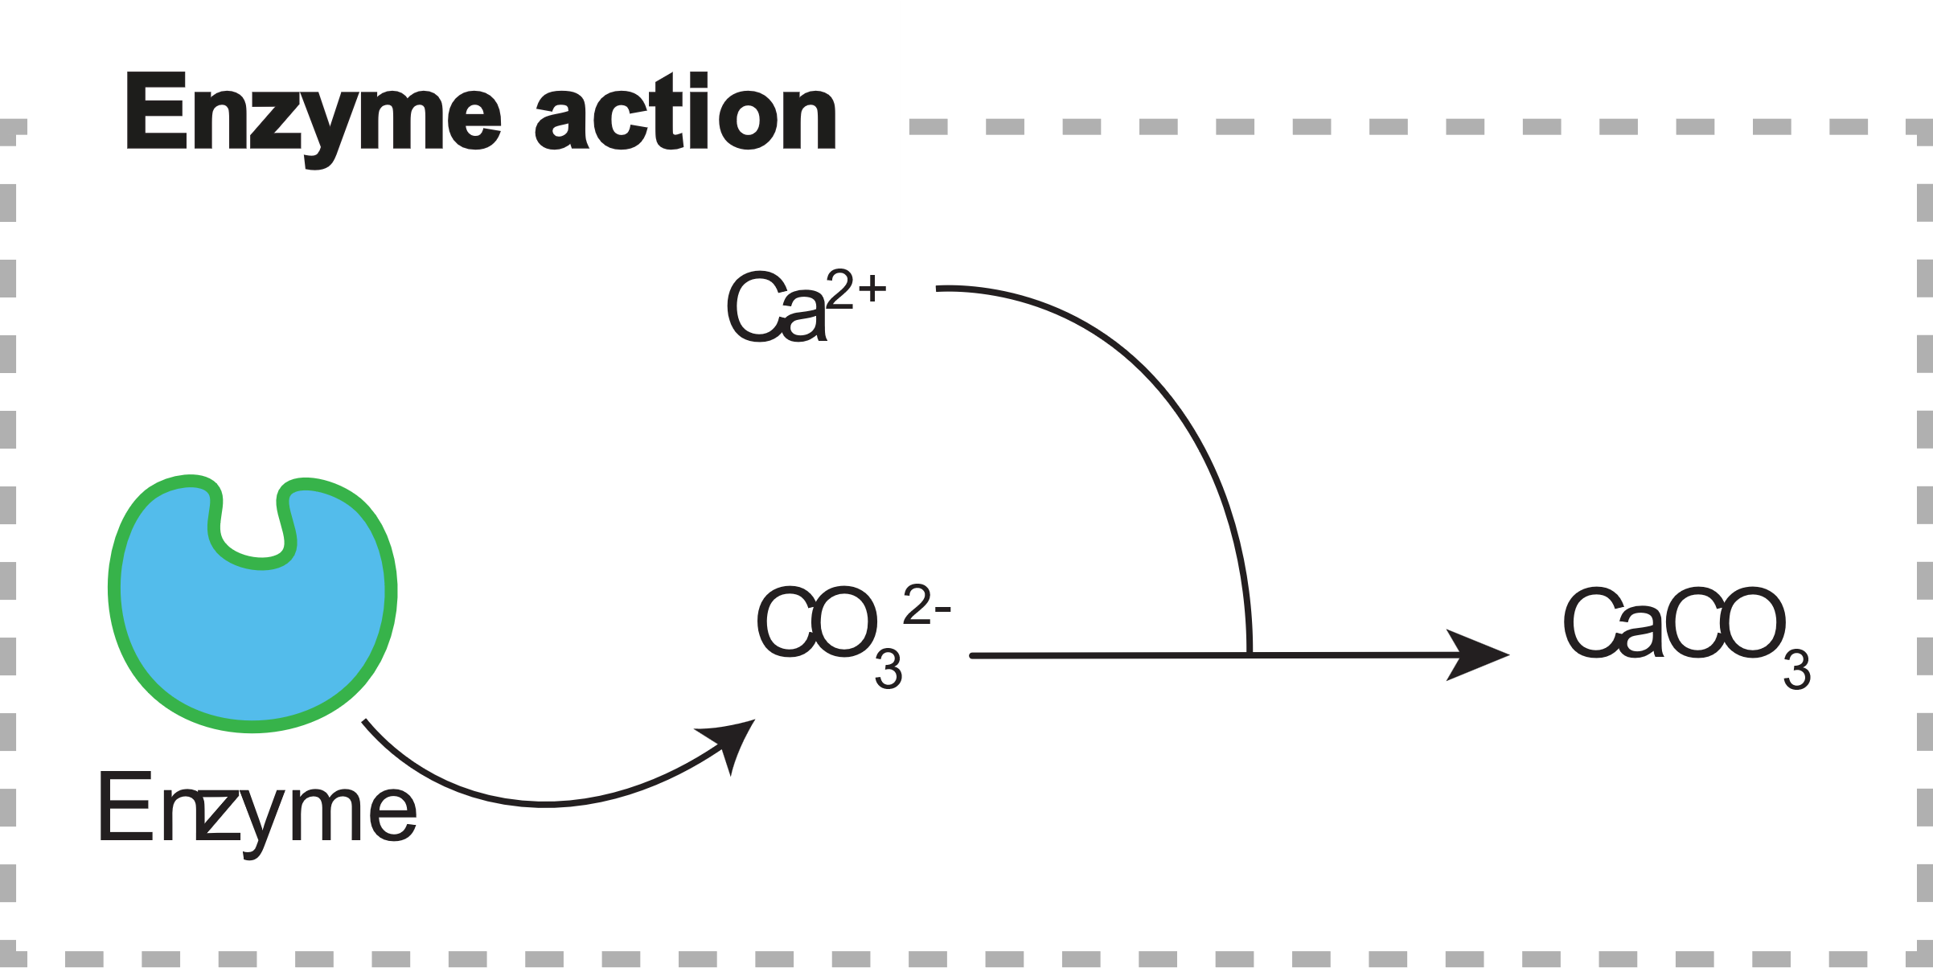
Double Network Granular Hydrogel
Notes:
uCT scans

